Slide 1
XSLT

Slide 2
What is XSL?
XSL - EXtensible Stylesheet Language
It is W3 standard

Slide 3
CSS = Style Sheets for HTML
CSS
  HTML uses predefined tags, and the meaning of each tag is well understood.
  The <table> tag in HTML defines a table - and a browser knows how to display it.
  Adding styles to HTML elements are simple. Telling a browser to display an element in a special font or color, is easy with CSS.

Slide 4
XSL = Style Sheets for XML
XML does not use predefined tags and meaning of each tag is not well understood.
A <table> tag
  could mean an HTML table, a piece of furniture, or something else
  browser does not know how to display it.
XSL describes how the XML document should be displayed!

Slide 5
XSL - More Than a Style Sheet Language
XSL consists of three parts
  XSLT - a language for transforming XML documents
  XPath - a language for navigating in XML documents
  XSL-FO - a language for formatting XML documents

Slide 6
...Contd
XSLT
A language for Transforming XML document
XPath
Expression language used by XSLT to locate
elements and attributes in an XML doc.
XSL-FO (Formatting Objects)
Specifies formatting properties for rendering the
document to some other format.

Slide 7
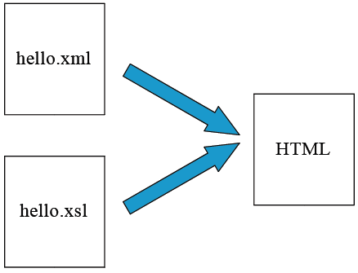
XML Transformation Example

Slide 8
Elements in XSLT - Examples
1. <xsl:template match="/">
</xsl:template>
2. <xsl:value-of select="catalog/cd/title”</xsl:value>
3. <xsl:for-each select="catalog/cd">
</xsl:for-each>
4. <xsl:sort select="artist"/>

Slide 9
...Contd
5. <xsl:if test="price &gt; 10">
<xsl:value-of select="title"/>
</xsl:if>
6. <xsl:choose>
<xsl:when test="expression">
... some output ...
</xsl:when>
<xsl:otherwise>
... some output ....
</xsl:otherwise>
</xsl:choose>

Slide 10
XSLT Stylesheet elements
Matching and selection templates
  – xsl:template
  – xsl:applytemplates
  – xsl:valueof
Branching elements
  – xsl:foreach
  – xsl:if
  – xsl:choose
Sorting element
  – xsl:sort

Slide 11
Sample cd.xml
<?xml version="1.0" encoding="ISO-8859-1"?>
<?xml-stylesheet type="text/xsl" href=“cd.xsl"?>
<catalog>
<cd>
<title>Empire Burlesque</title>
<artist>Bob Dylan</artist>
<country>USA</country>
<company>Columbia</company>
<price>10.90</price>
<year>1985</year>
</cd>
.
.
</catalog>

Slide 12
Book.xml
<?xml version="1.0" encoding="ISO-8859-1"?>
<!-- Edited by XMLSpy® -->
<store>
<book title="Computer Networks" lang="tamil">
<author>Andrew</author>
<author>Tanenbaum</author>
<price>130</price>
</book>
<book title="Web Technology" lang="en">
<author>Jeffrey</author>
<author>Jackson</author>
<price>250</price>
</book>
</store>

Slide 13
Xsl:template
An XSL style sheet consists of one or more set of rules that are called templates.
Each template contains rules to apply when a specified node is matched.
The <xsl:template> element is used to build templates.
The match attribute is used to associate a template with an XML element.
The value of the match attribute is an XPath expression.

Slide 14
Sample cd.xsl
<?xml version="1.0" encoding="ISO-8859-1"?>
<xsl:stylesheet version="1.0"
xmlns:xsl="http://www.w3.org/1999/XSL/Transform">
<xsl:template match="/">
<html>
<body>
<h2>My CD Collection</h2>
<table border="1">
<tr bgcolor="#9acd32">
<th>Title</th>
<th>Artist</th>
</tr>

Slide 15
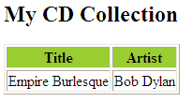
…Contd
xsl:for-each select="catalog/cd">
<tr>
<td><xsl:value-of select="title"/></td>
<td><xsl:value-of select="artist"/></td>
</tr>
</xsl:for-each>
</table>
</body>
</html>
</xsl:template>
</xsl:stylesheet>

Slide 16
<xsl:for-each>
<xsl:for-each> – allows you to do looping in XSLT.
<xsl:template match="/">
<html>
<body>
<h2>My CD Collection</h2>
<table border="1">
<tr bgcolor="#9acd32"> <th>Title</th><th>Artist</th></tr>
<xsl:for-each select="catalog/cd">
<tr>
<td><xsl:value-of select="title"/></td>
<td><xsl:value-of select="artist"/></td>
</tr>
</xsl:for-each>
</table>
</body>
</html>
</xsl:template>
</xsl:stylesheet>

Slide 17

<xsl:for-each> Predicate
<xsl:for-each select="catalog/cd[artist='Bob Dylan']">
<tr>
<td><xsl:value-of select="title"/></td>
<td><xsl:value-of select="artist"/></td>
</tr>
</xsl:for-each>

Slide 18
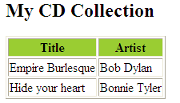
<xsl:sort>
<xsl:template match="/">
<html>
<body>
<h2>My CD Collection</h2>
<table border="1">
<tr bgcolor="#9acd32"> <th>Title</th> <th>Artist</th> </tr>
<xsl:for-each select="catalog/cd">
<xsl:sort select="artist"/>
<tr>
<td><xsl:value-of select="title"/></td>
<td><xsl:value-of select="artist"/></td>
</tr>
</xsl:for-each>
</table>
</body>
</html>
</xsl:template>
</xsl:stylesheet>

Slide 19
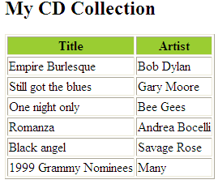
<xsl:if>
<xsl:for-each select="catalog/cd">
<xsl:if test="price &gt; 10">
<tr>
<td><xsl:value-of select="title"/></td>
<td><xsl:value-of select="artist"/></td>
</tr>
</xsl:if>
</xsl:for-each>

Slide 20
The <xsl:choose> Element
<xsl:choose> – used in conjunction with <xsl:when> and
<xsl:otherwise> to express multiple conditional tests.
<xsl:choose>
<xsl:when test="expression">
... some output ...
</xsl:when>
<xsl:otherwise>
... some output ....
</xsl:otherwise>
</xsl:choose>

Slide 21
<xsl:choose>
<xsl:for-each select="catalog/cd">
<tr>
<td><xsl:value-of select="title"/></td>
<xsl:choose>
<xsl:when test="price &gt; 10">
<td bgcolor="#ff00ff">
<xsl:value-of select="artist"/></td>
</xsl:when>
<xsl:otherwise>
<td><xsl:value-of select="artist"/></td>
</xsl:otherwise>
</xsl:choose>
</tr>
</xsl:for-each>

Slide 22
<xsl:applytemplates>
<xsl:applytemplates>
– applies a template to the current element or to the current element's child nodes.
The select attribute to <xsl:apply-templates> element, will process only the child element that matches the value of the attribute.
Use the select attribute to specify the order in which the child nodes are processed.

Slide 23
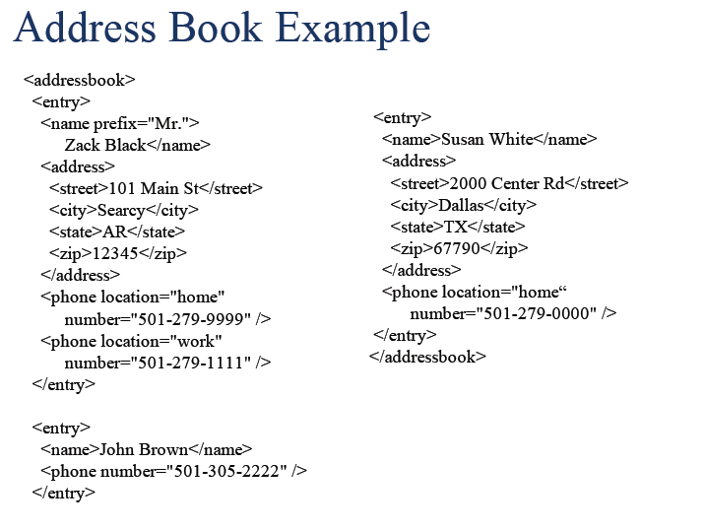

Slide 24
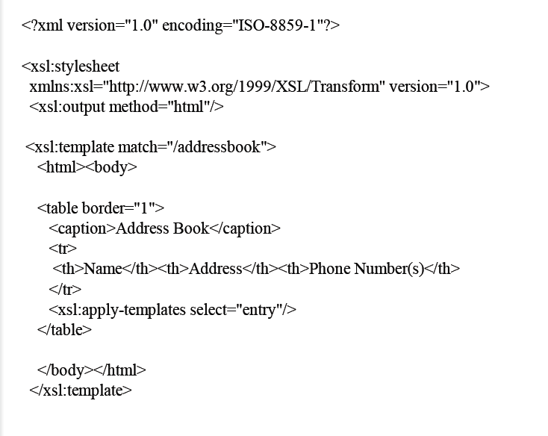

Slide 25
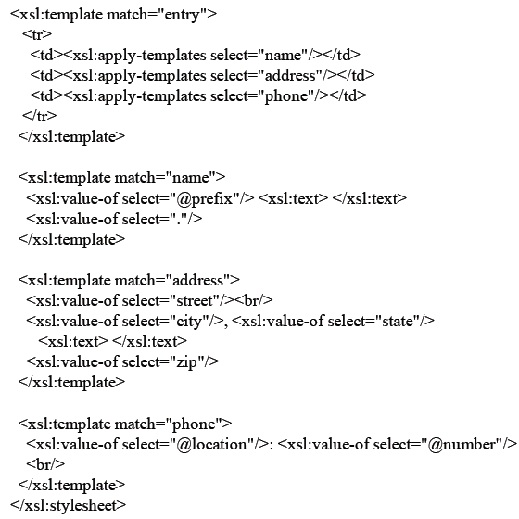

Slide 26
